Slide 1




Astronomy 1010 chapter 15
Clayton State University
Slides for Astronomy textbook from OpenStax
https://openstax.org/books/astronomy/

Slide 2
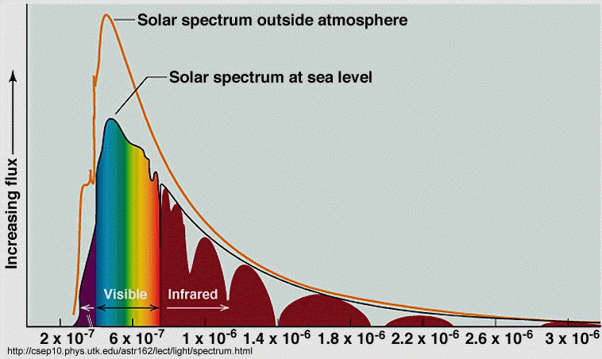
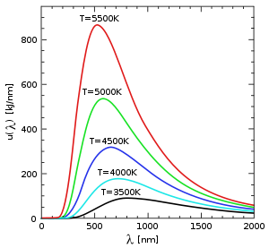
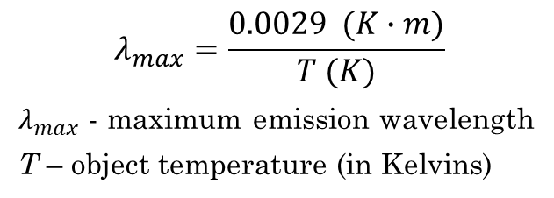
Wien’s Law
Solar spectrum
Any heated solid or highly compressed gas gives continuous spectrum. Depends (mostly) on temperature alone (very weakly on composition).
Wien’s law is used to find the brightest color
$$λ_{max}=\frac{0.0029 (K∙m)}{T (K)}$$
$λ_{max}$ - maximum emission wavelength
T – object temperature (in Kelvins)

Slide 3
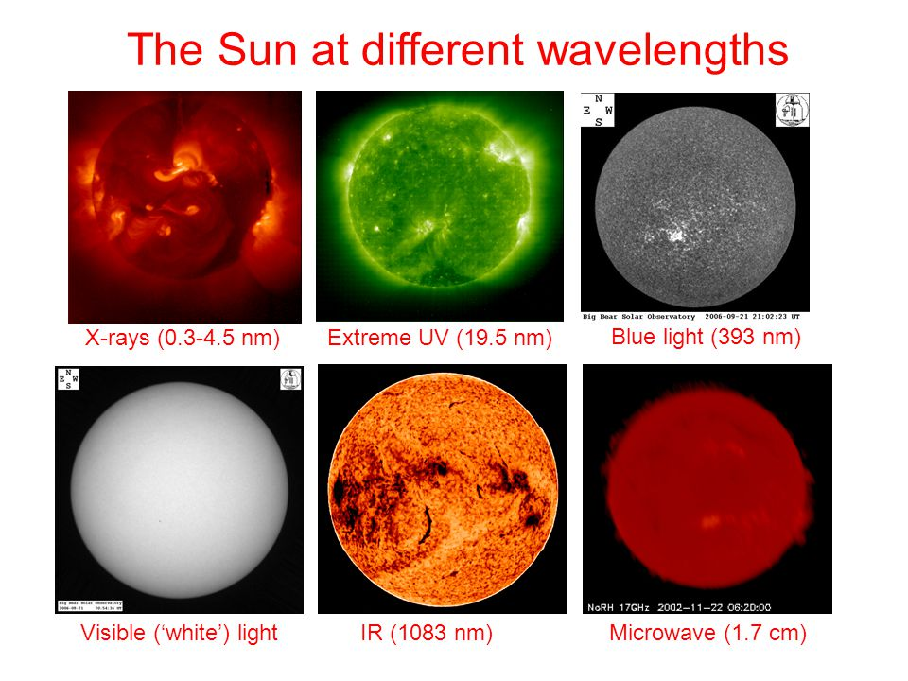
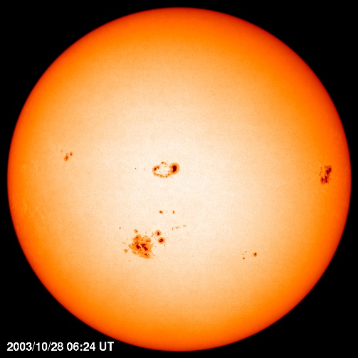
Sun in different wavelengths

Slide 4
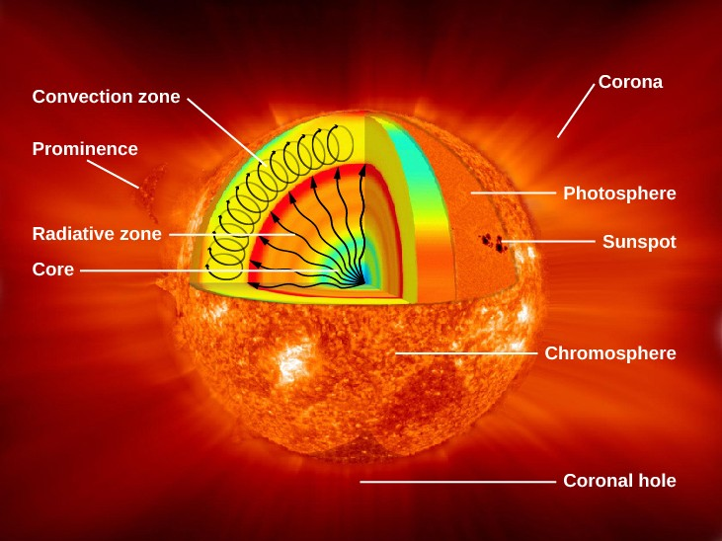
The structure of the Sun

Slide 5
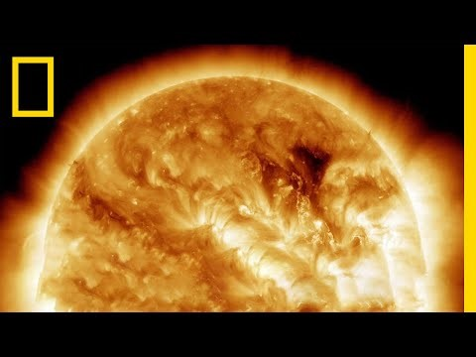
Sun’s structure

Slide 6
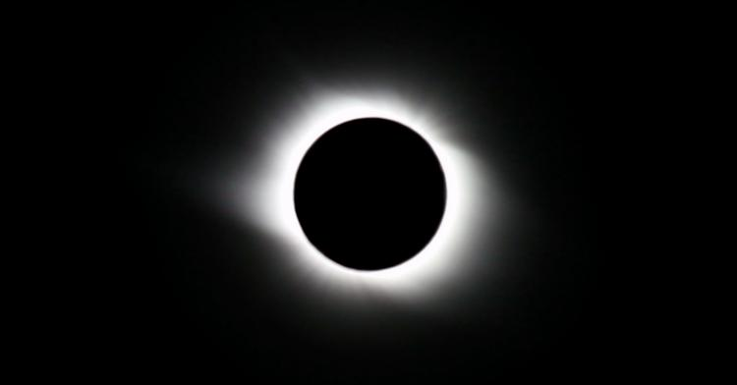
Total eclipse
Chromosphere and corona are visible!

Slide 7
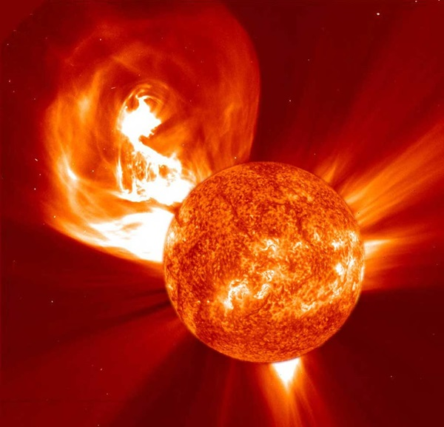
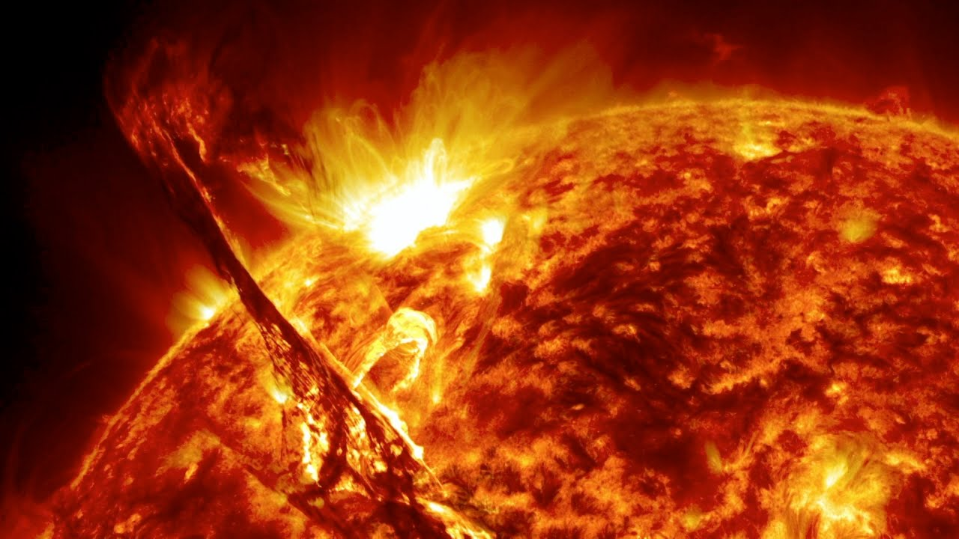
Flares and mass ejections

Slide 8
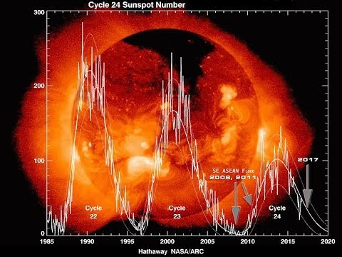
Sun’s activity cycle and sunspots

Slide 9
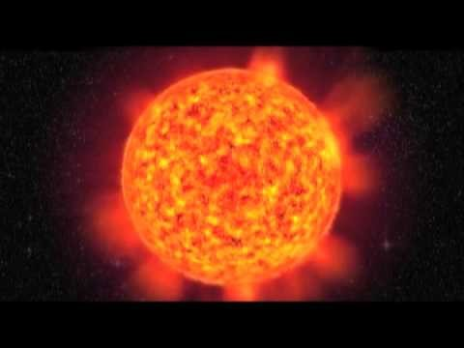
Effects on Earth

Slide 10
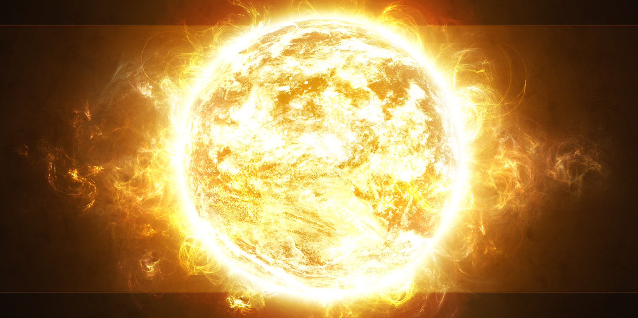

Any questions?
What makes out Sun different from most of the other stars?

